Slide 1

Practical 15
Write a program for Lowest Common Ancestors.

Slide 2

Lesson Plan
Subject/Course | Competitive Coding
Lesson Title | Lowest Common Ancestor (LCA) in a Binary Tree
Lesson Objectives
Understand the concept of the Lowest Common Ancestor (LCA) in a binary tree.
Learn how to trace paths of two nodes and identify their shared ancestor.
Implement recursive logic to efficiently find the LCA.
Analyze the time and space complexity of the LCA approach.

Slide 3
Problem Statement:
Given a binary tree and two node values, find their Lowest Common Ancestor (LCA).
If one node is the ancestor of the other, return that node itself.

Slide 4
Concept
The Lowest Common Ancestor (LCA) of two nodes n1 and n2 in a binary tree is the lowest (deepest) node that has both n1 and n2 as descendants.
In simpler terms, it’s the common parent of both nodes that appears lowest in the tree.
We can find the LCA efficiently using recursion.

Slide 5
Algorithm/Logic
If the root is NULL, return NULL.
If the root matches either of the two target nodes, return the root.
Recursively search for the two nodes in the left and right subtrees.
If both sides return non-NULL, the current node is the LCA.
Otherwise, return the non-NULL side.

Slide 6
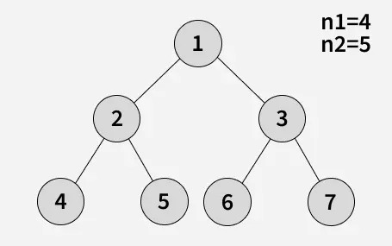
Visualization
Output: 2
Explanation: As shown below, LCA of 4 and 5 is 2.

Slide 7
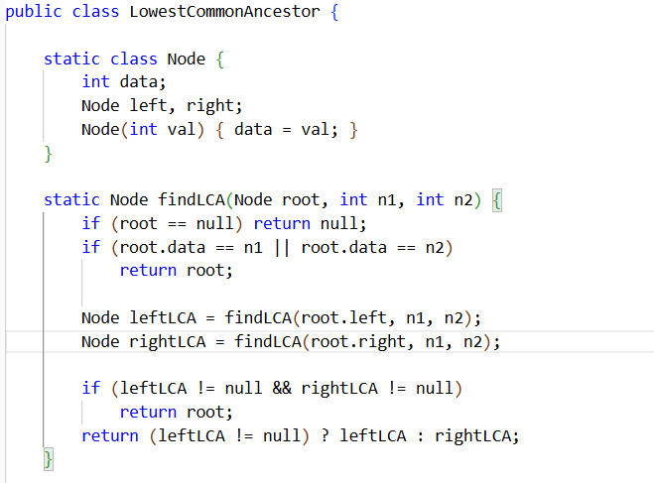
Code Implementation

Slide 8
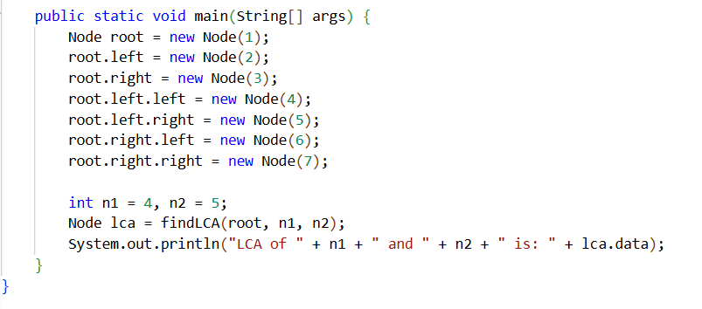

Output :

Slide 9
Time & Space Complexity
Operation | Time Complexity | Space Complexity | Explanation
Find LCA (Recursive) | O(n) | O(h) | Traverses all nodes; recursion depth = tree height (h).

Slide 10
Summary
The Lowest Common Ancestor (LCA) identifies the shared parent of two given nodes.
Solved efficiently using recursion with O(n) time complexity.
Widely used in network routing, taxonomy classification, and organization hierarchies.

Slide 11
Practice Questions:
Lowest Common Ancestor of a Binary Tree — LeetCode #236 🔗 https://leetcode.com/problems/lowest-common-ancestor-of-a-binary-tree/
Concept: Use recursion to find the deepest common parent node between two given nodes in a binary tree.
Why Practice:
Reinforces recursive tree traversal logic.
Builds foundation for graph ancestry and path problems.

Slide 12
Practice Questions:
2. Lowest Common Ancestor of a Binary Search Tree — LeetCode #235
🔗 https://leetcode.com/problems/lowest-common-ancestor-of-a-binary-search-tree/ Difficulty: Medium
Concept: Find LCA in a Binary Search Tree using BST properties.
Why Practice: Strengthens understanding of BST ordering rules. Teaches how structural properties can simplify recursion.

Slide 13
Practice Questions:
3. Smallest Subtree with all the Deepest Nodes — LeetCode #865
🔗 https://leetcode.com/problems/smallest-subtree-with-all-the-deepest-nodes/ Difficulty: Medium
Concept: Return the smallest subtree that contains all the deepest nodes in the tree.
Why Practice: This is a variation of LCA thinking. Requires identifying lowest common ancestor of deepest nodes.

Slide 14
Thanks

